Slide 1


Data Analysis
On
Risk in banking and financial services
ROOM 15- THE RISK ANALYZERS
MRINAL MURALI M
NAGA SAI GANA VIDYA DARI P
S KOUSHALYA
SHRUTHI

Slide 2
Introduction
Why this?
We have taken data on risk analytics in banking and financial services as it is a real world scenario.
There are many factors taken into consideration - about 159 fields checks if a client is to eligible for loan.

Slide 3
THE PRIME QUESTIONS !!!
“ Ironically, In The World of Data Science, the right Questions are more valuable than data itself” !!!
Are the customers facing bias ?
What Factors are more responsible for loan approval or rejection ?
What is the impact of previous loan application on new application ?

Slide 4

STEPS
1.Cleansing of data
2.Data Transformation
3. Data Visualization
Before analysing data we should first ask if the data is accurate ?
The data under consideration has 2 separate datasets and many columns have missing values
In cleansing of data we have to:
Check for NA values
Remove if the values are higher in number
If less, add the mean/median/mode value as the missing value

Slide 5
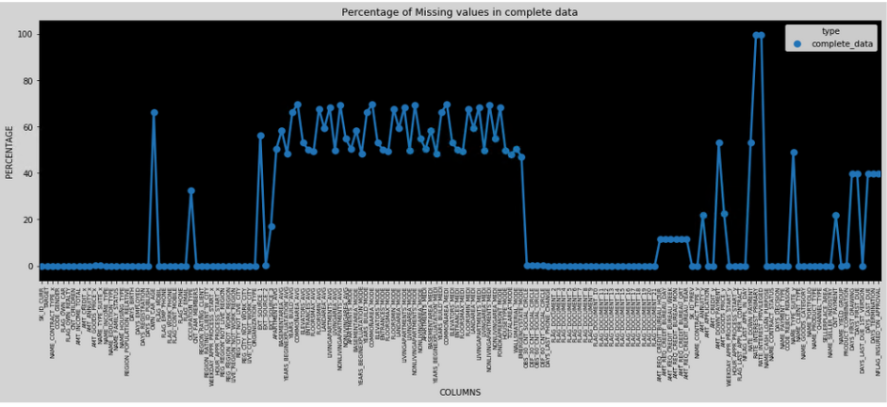
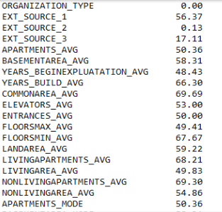
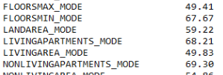
cleansing of Data
Before cleansing
…………………………………….

Slide 6
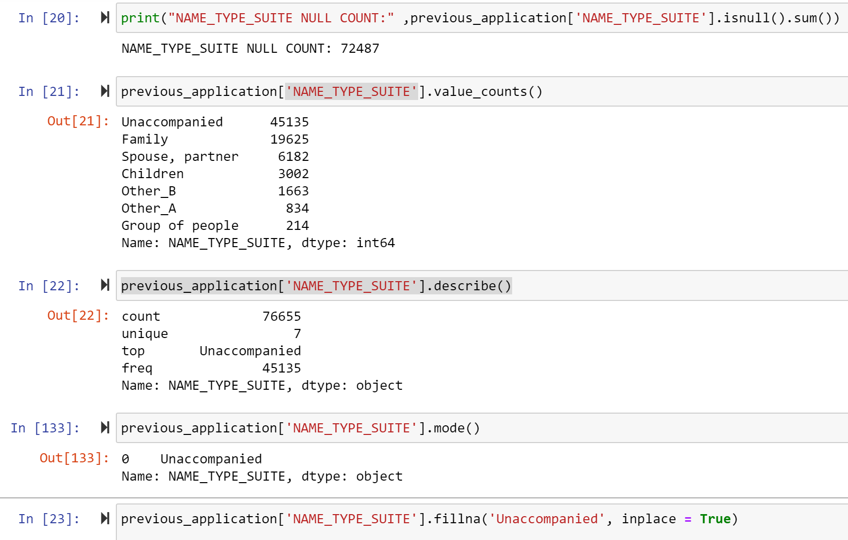
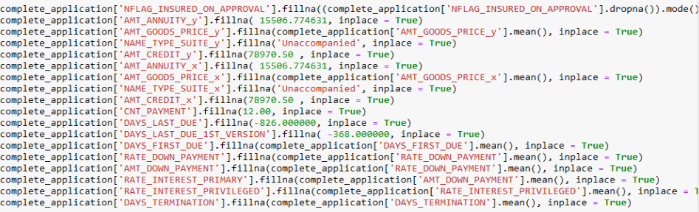
Using different functions to replace null values with suitable measures of central tendency

Slide 7
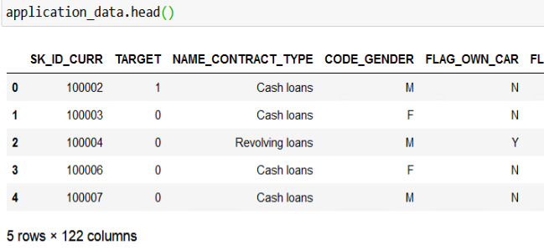
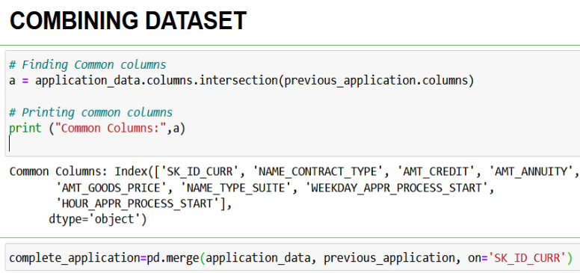
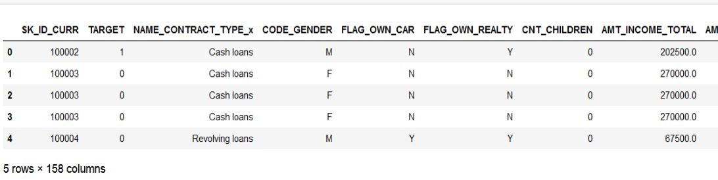
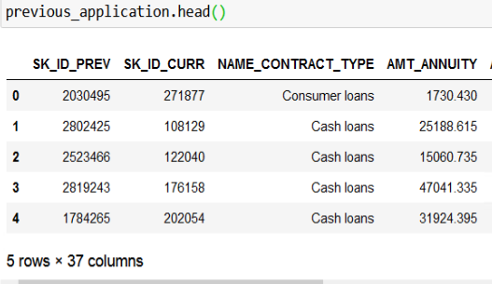
RESULT OF DATA COMBINATION and FEATURE SELECTION

Slide 8
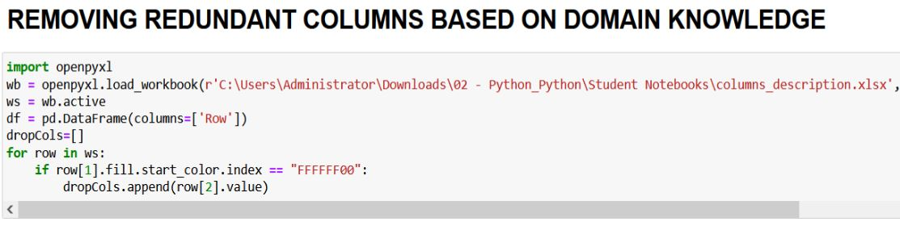
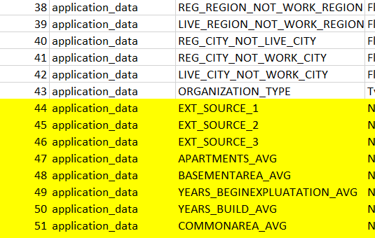
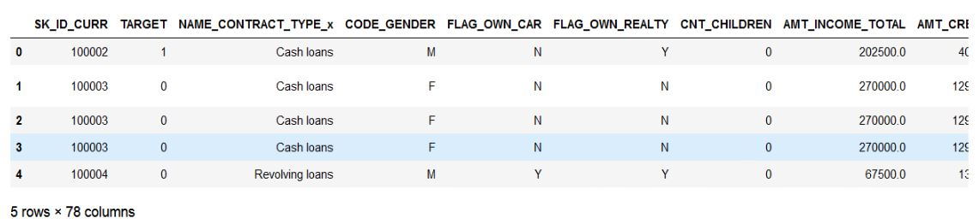
RESULT OF DATA COMBINATION and FEATURE SELECTION

Slide 9
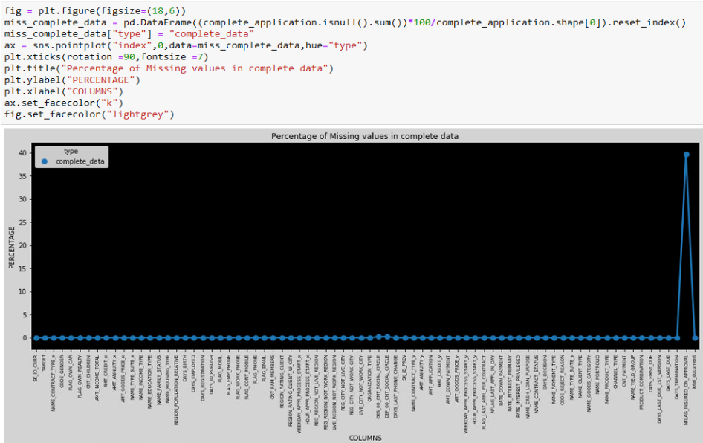
The result for cleansing Combined Data

Slide 10
HYPOTHESES AND SUPPORTING DATA VISUALIZATIONS

Slide 11
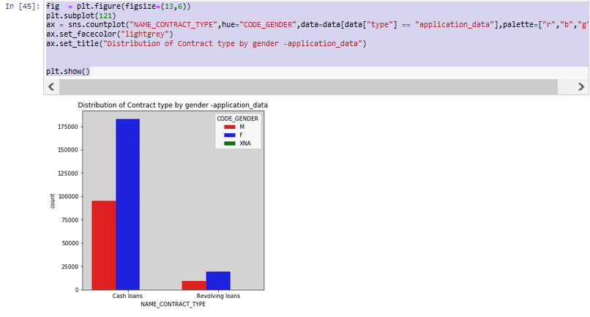
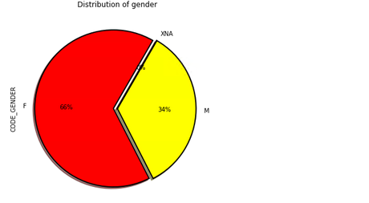
DATA visualisation
STATISTICAL METRICS SHOW ABSENCE OF GENDER BIAS

Slide 12
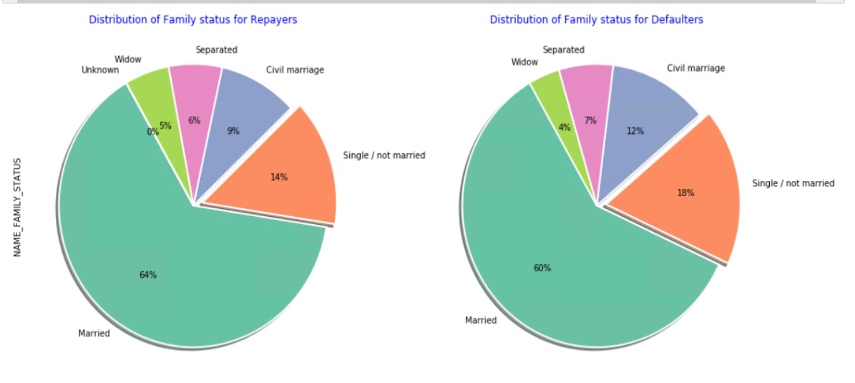
DATA VISUALIZATION
FAMILY STATUS DISTRIBUTION OF REPAYERS AND DEFAULTERS ARE SIMILAR.
HENCE, FAMILY STATUS SHOULD NOT BE A BIAS TO TO DECIDE LOAN APPROVAL

Slide 13
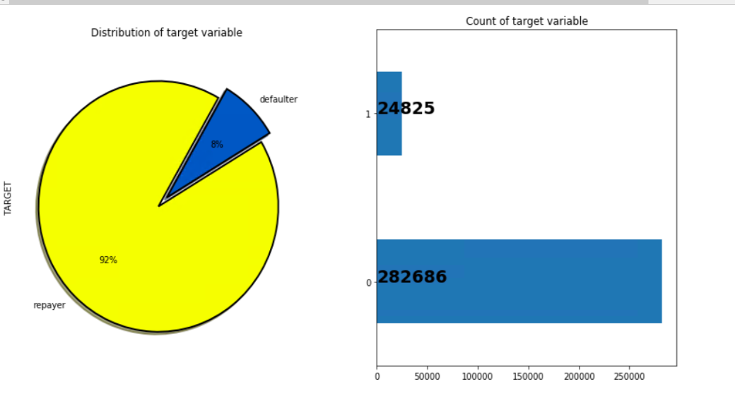
DATA VISUALIZATION
SOCIETY IS HEADED IN GOOD DIRECTION, MAJORITY REPAY THE LOANS

Slide 14
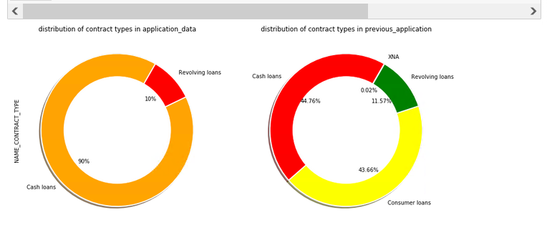
DATA VISUALIZATION-LOAN TYPE
CASH LOANS ARE MOSTLY PREFERRED

Slide 15
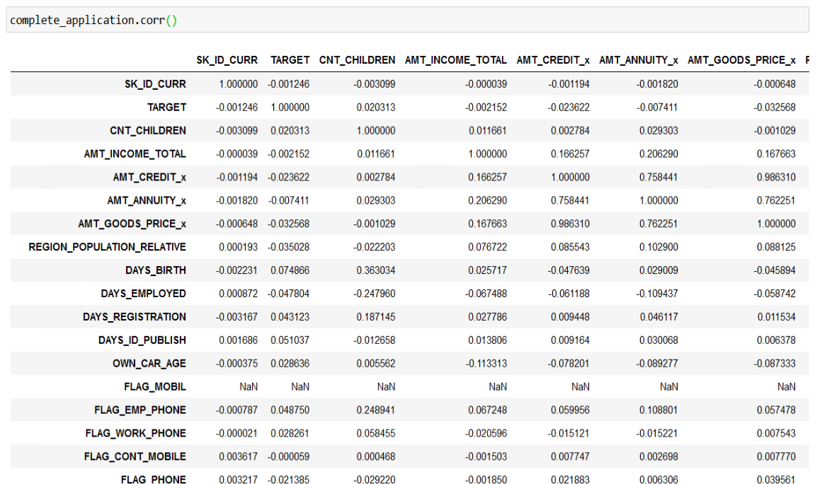
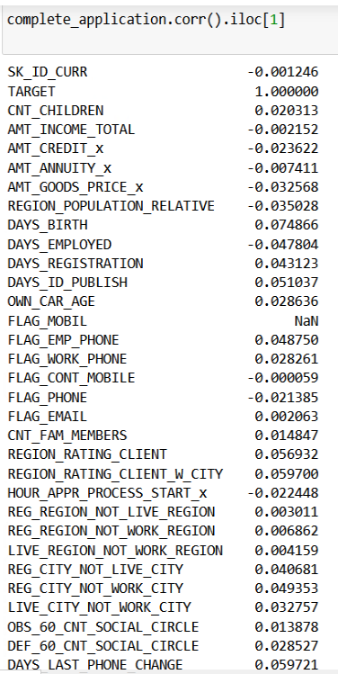
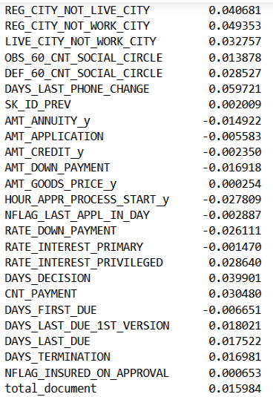
CORRELATION
IMPACT OF PREVIOUS LOAN APPLICATION

Slide 16
Conclusion
Upon extensive exploratory data analysis we conclude that :-
Loan Approval is unbiased, from an ethical standpoint
Payment difficulties from the previous application is the most responsible factor for loan approval/rejection
Cash Loans are the most preferred loan types
Previous Application has a high impact on current application

